Slide 1
Outline
INTRODUCTION
Backgrounds
Performance Vs Cost
Multithreading
HYPER THEARDING TECHNOLOGY
Duplication by HT
HT Goals
Trace cache miss and hit
HT Execution
OS support by HT
Applications
Conclusion

Slide 2
BACKGROUNDS
The amazing growth of the Internet and telecommunications is powered by ever-faster systems demanding increasingly higher levels of processor performance.
Micro architecture techniques used to achieve past processor performance improvement have made microprocessors increasingly more complex, have more transistors, and consume more power
But, transistor counts and power are increasing at rates greater than processor performance.

Slide 3
Why Thread Your Application?
Increased responsiveness and worker productivity
Increased application responsiveness when different tasks run in parallel.
Improved performance in parallel environments
When running computations on multiple processors.
More computation per cubic foot of data center
Web-based apps are often multi-threaded by nature.
Performance + responsiveness makes it easier to add new features
Taking full advantage of Multi-Core hardware requires,
Multi-threaded softwares.

Slide 4
Multithreading
Time that processors wasted running single tasks while waiting for certain events to complete, software developers began wondering if the processor could be doing some other work at the same time.
To arrive at a solution, software architects began writing operating systems that supported running pieces of programs, called threads.
Threads are small tasks that can run independently. Each thread gets its own time slice, so each thread represents
one basic unit of processor utilization.
Threads are organized into processes, which are composed of one or more threads. All threads in a process share access to the process resources.

Slide 5
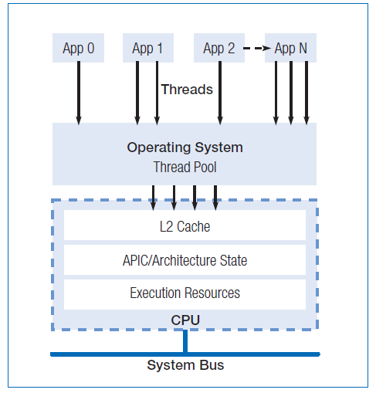
These multithreading operating systems made it possible for one thread to run while another was waiting for something to happen. To benefit from multithreading, programs need to possess executable sections that can run in parallel.

Slide 6
Hyper Threading Technology
Presents software with two logical processors even though only one physical processor is present. Effectively doubling the number of CPUs seen by the OS.
The OS is tricked into seeing two processors because a HT processor has two sets of architectural sate resources.
It is still technically only a single processor because the compute resources (execution units) are not doubled.

Slide 7
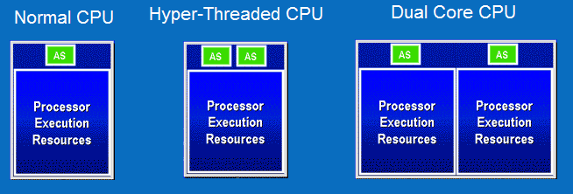
Each logical processor
Has its own architecture state
Executes its own code stream concurrently
Can be interrupted and halted independently
The two logical processors share the same
Execution engine and the caches
Firmware and system bus interface

Slide 8
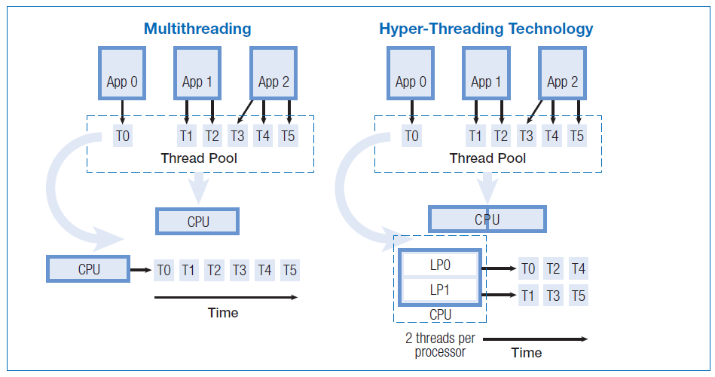

Slide 9
Shared Resources
Caches: trace cache, L1, L2, L3
Execution Units
They are fully shared to improve the dynamic
utilization of the resource.

Slide 10
Hyper-Threading Goals
Minimize die area cost for implementing
Ensure forward progress by at least one logical processor
Maintain single-threaded performance

Slide 11
Operating Systems Support for HT
Native HT Support
Windows XP Pro Edition
Windows XP Home Edition
Windows 7
Linux v 2.4.x (and higher)
Compatible with HT
Windows 2000 (all versions)
Windows NT 4.0 (limited driver support)
No HT Support
Windows ME
Windows 98 (and previous versions)

